Slide 2


Slide 3

The Will Of The Father
Matt. 7:21; 12:50; Mk. 3:35; Jn. 1:13; 4:34; 5:30; 6:38-40;
Rom. 8:27; 12:2; 2 Cor. 7:9-10; Gal. 1:4; 1 Pet. 4:2,19; 5:2
(1 Cor. 1:1; 2 Cor. 1:1; Eph. 1:1; Gal. 1:1; 2 Tim. 1:1)
The Will Of God
1 John 2:17

Slide 4



Father’s
Will
Matt. 7:21 “Not everyone who says to Me, ‘Lord, Lord,’ will enter the kingdom of heaven; but he who does the will of My Father who is in heaven. (22) “Many will say to Me on that day, ‘Lord, Lord, did we not prophesy in Your name, and in Your name cast out demons, and in Your name perform many miracles?’ (23) “And then I will declare to them, ‘I never knew you; DEPART FROM ME, YOU WHO PRACTICE LAWLESSNESS.’
Son
Holy Spirit
Apostle
Men

Slide 5

Heb. 1:1-3 God Spoke…
“I can do nothing on My own initiative. As I hear, I judge; and My judgment is just, because I do not seek My own will, but the will of Him who sent Me. John 5:30 (17-24)
(8:28) Jesus therefore said, “When you lift up the Son of Man, then you will know that I am He, and I do nothing on My own initiative, but I speak these things as the Father taught Me.
12:48-50 I did not speak on My own initiative… I speak just as the Father has told Me.
7:16-18 My teaching is not Mine…
If any man is willing to do His will…
He who speaks from himself seeks his own glory
Father’s
Will
Hebrews
10:7, 9
Son
Holy Spirit
Apostle
Men

Slide 6
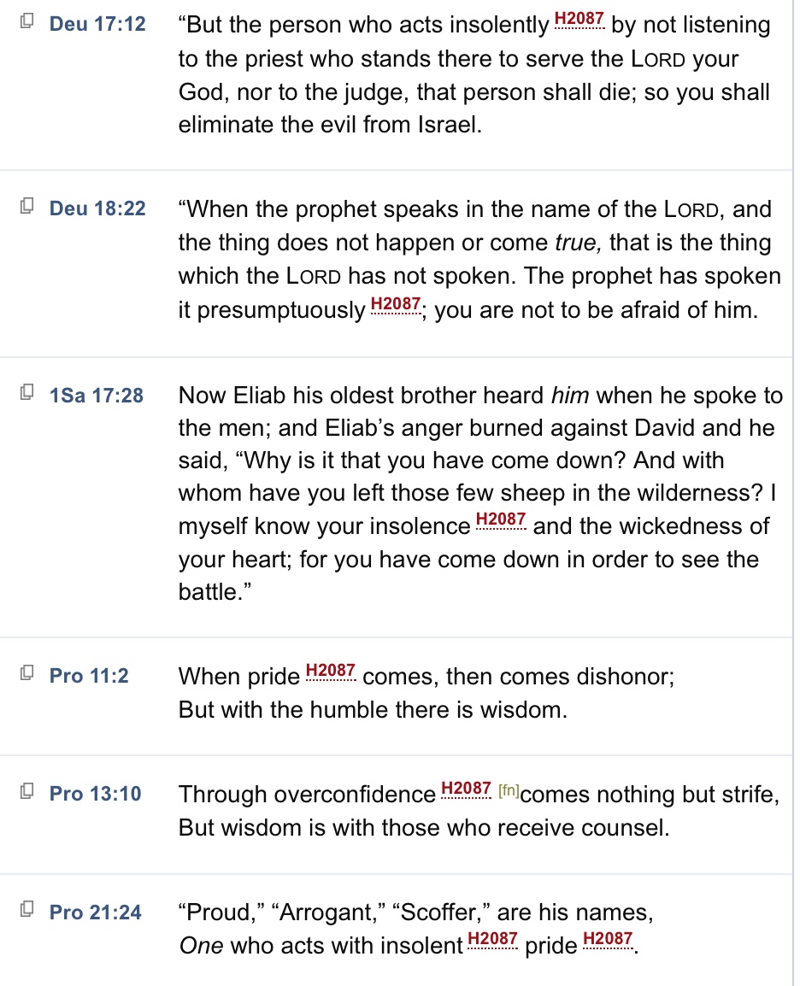
Father’s
Will
Pride, Insolently
Son
Presumptuous
Holy Spirit
Apostle
Men

Slide 7
“But when He, the Spirit of truth, comes, He will guide you into all the truth; for He will not speak on His own initiative, but whatever He hears, He will speak; and He will disclose to you what is to come.
John 16:13
Father’s
Will
Son
Holy Spirit
“But the Helper, the Holy Spirit, whom the Father will send in My name, He will teach you all things, and bring to your remembrance all that I said to you.
John 14:26
Apostle
Men

Slide 8
John 16:13
“But when He, the Spirit of truth, comes, He will guide you into all the truth; for He will not speak on His own initiative, but whatever He hears, He will speak; and He will disclose to you what is to come.
Matthew 16:19; 18:18 (shall have been bound in heaven)
Father’s
Will
Son
Acts 2:42; John 13:20; 20:21;
Matt. 10:40; Lk. 10:16; 1 Cor. 11:2-3
Eph. 3:3-5 (Apostles and Prophets)
1 Cor. 4:17 Everywhere In Every Church
Holy Spirit
(8) But even though we, or an angel from heaven, should preach to you a gospel contrary to (other than) that which we have preached to you, let him be accursed. (9) As we have said before, so I say again now, if any man is preaching to you a gospel contrary to that which you received, let him be accursed.
Galatians 1:8-9
Apostles
Men

Slide 9
“for the words which You gave Me I have given to them; and they received them and truly understood that I came forth from You, and they believed that You sent Me.”
John 17:8
Father’s
Will
Son
2 Pet. 3:1-2
Holy Spirit
(8) But even though WE, or an angel from heaven, should preach to you a gospel contrary to (other than) that which we have preached to you, let him be accursed. (9) As we have said before, so I say again now, if any man is preaching to you a gospel contrary to that which you received, let him be accursed.
Galatians 1:8-9
Apostles
Men

Slide 10
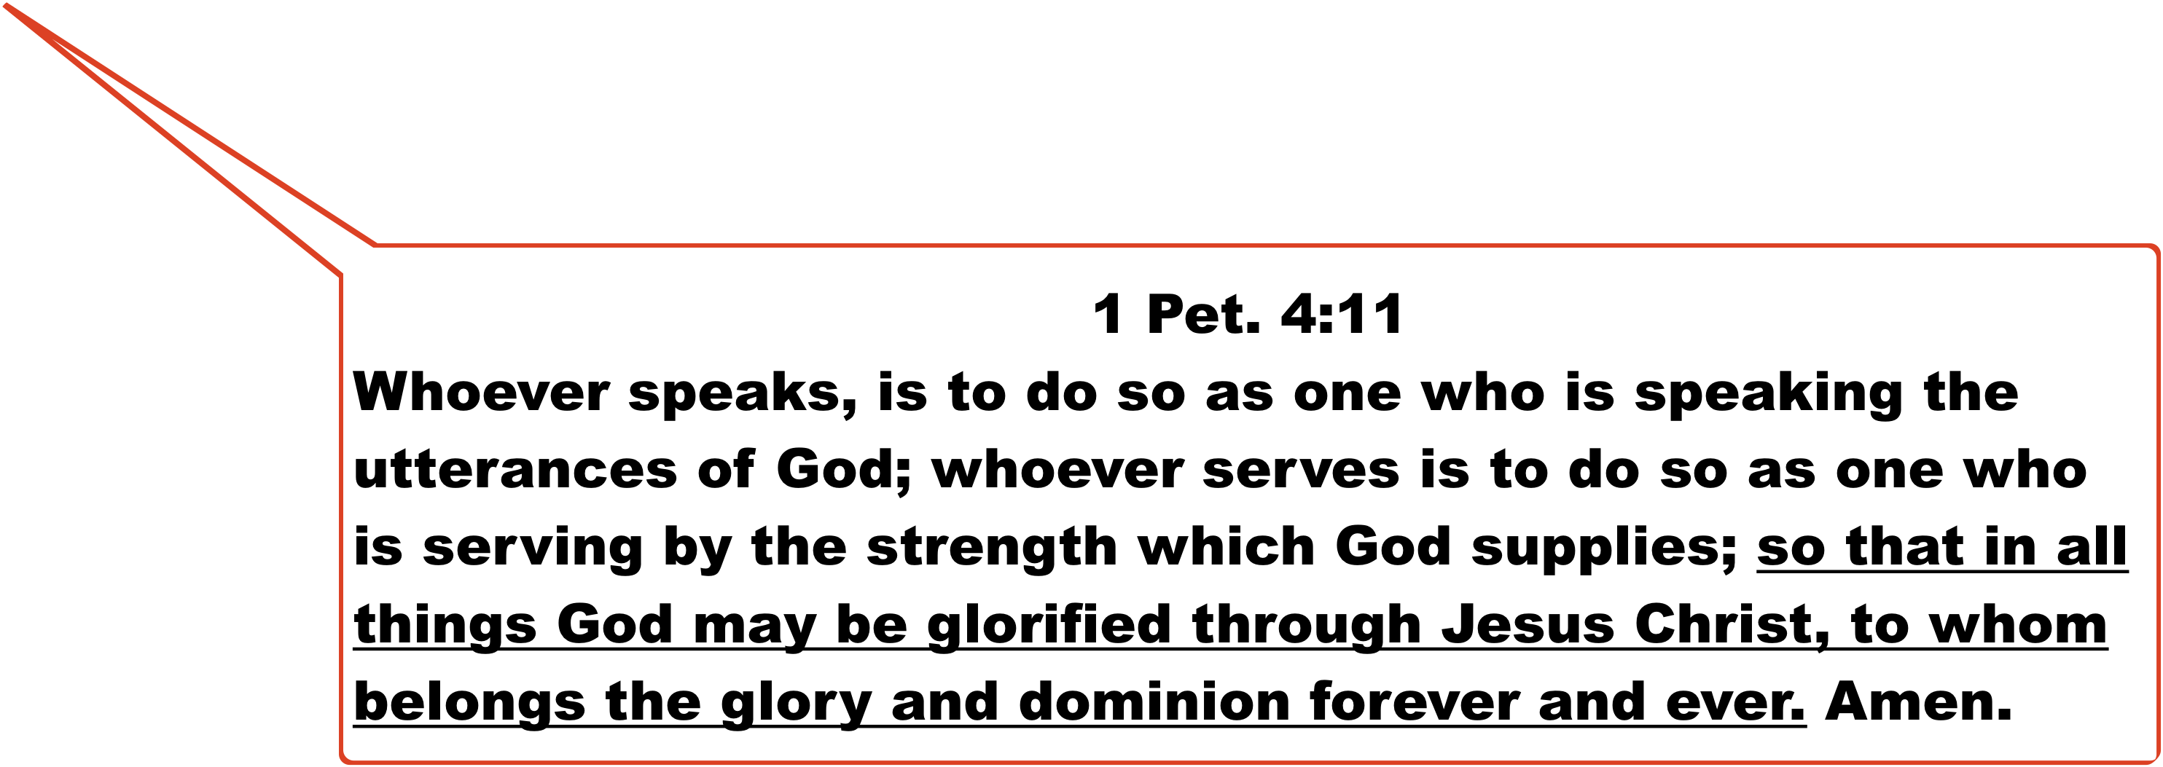

2 Tim. 3:16
All Scripture Inspired By God…
(16) All Scripture is inspired by God and profitable for teaching, for reproof, for correction, for training in righteousness; (17) that the man of God may be adequate, equipped for every good work.
Father’s
Will
Son
Holy Spirit
Apostle
Men

Slide 11

“But when He, the Spirit of truth, comes, He will guide you into all the truth; for He will not speak on His own initiative, but whatever He hears, He will speak; and He will disclose to you what is to come.
John 16:13
Father’s
Will
2 Pet. 2:1; 1 Jn. 4:1-7
(8) But even though we, or an angel from heaven, should preach to you a gospel contrary to that which we have preached to you, let him be accursed. (9)As we have said before, so I say again now, if any man is preaching to you a gospel contrary to that which you received, let him be accursed.
Gal. 1:8-9
When Men Speak Their Own Will…
“BUT I AM A PROPHET OF GOD…”
Son
Holy Spirit
Apostle
Men

Slide 12

2 Pet.
1:20-21
Study Of The Bible Is not about…
determining what Scripture says
but Is about Discovering What It Says.
1 Cor.
2:10-16
It Is Already Determined!
Matt.
4:4
1 Pet.
4:11
Man does not live by bread alone, but by every word that proceeds from the mouth of God.
John
7:16-18

Slide 13
(2) Son of man, prophesy against the prophets of Israel who prophesy, and say to those who prophesy from their own inspiration, ‘Listen to the word of the LORD! (3) Thus says the Lord GOD, “Woe to the foolish prophets who are following their own spirit and have seen nothing”. Ezek. 13:2-3
Thus says the LORD of hosts, “Do not listen to the words of the prophets who are prophesying to you. They are leading you into futility; They speak a vision of their own imagination, Not from the mouth of the LORD. Jer. 23:16
2 Peter 1:20-21
Speaking From One’s Own Spirit
Ezekiel 13:2-3; Jeremiah 23:16

Slide 14

Father’s
Will
For we are not like many, peddling the word of God, but as from sincerity, but as from God, we speak in Christ in the sight of God.
2 Cor. 2:17
“…He has committed to us the word of reconciliation. (20) Therefore, we are ambassadors for Christ, as though God were entreating through us; we beg you on behalf of Christ, be reconciled to God.”
2 Cor. 5:19-20
Son
Holy Spirit
Apostle
Men

Slide 15

Father’s
Will
Son
For this reason we also constantly thank God that when you received the word of God which you heard from us, you accepted it not as the word of men, but for what it really is, the word of God, which also performs its work in you who believe.
1 Thessalonians 2:13
Holy Spirit
Apostle
Men

Slide 16
(31) Jesus therefore was saying to those Jews who had believed Him, “If you abide in My word, then you are truly disciples of Mine; (32) and you shall know the truth, and the truth shall make you free.”
John 8:31-32
(36) “If therefore the Son shall make you free, you shall be free indeed.

Slide 17
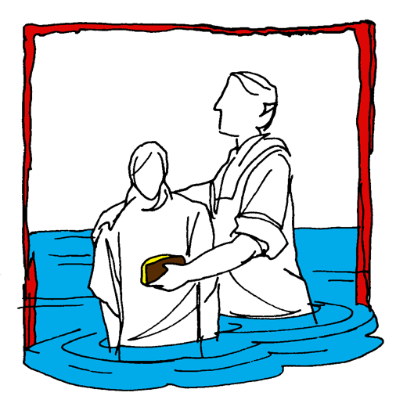


Hear (Rom. 10:17)
Believe (Jn. 8:24)
Repent (Acts 2:38)
Confess (Mt. 10:32-33)
Baptism (Acts 22:16)
Mk. 16:
15-16
Continue… (Matt. 28:20)
Committed To Follow Jesus

